Slide 1
LF 101:
Lecture 3 of 13:
1st March 2016

Slide 3
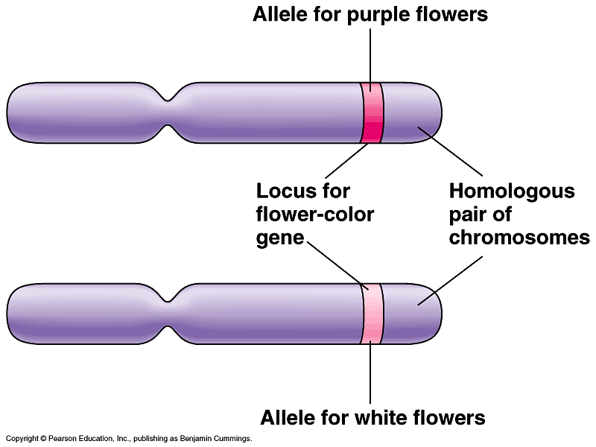
New Topic
Chromosomal basis of Mendelian inheritance
Mendel explained inheritance in pea in 1865 – it was not called a law in those days – it was hardly noticed. The physical basis of Mendelian inheritance was clear when chromosomes were discovered and their transmission in somatic cells (by Mitosis) and Gametes (Meiosis) was understood in the early 1900s
Summary of our current understanding

Slide 4
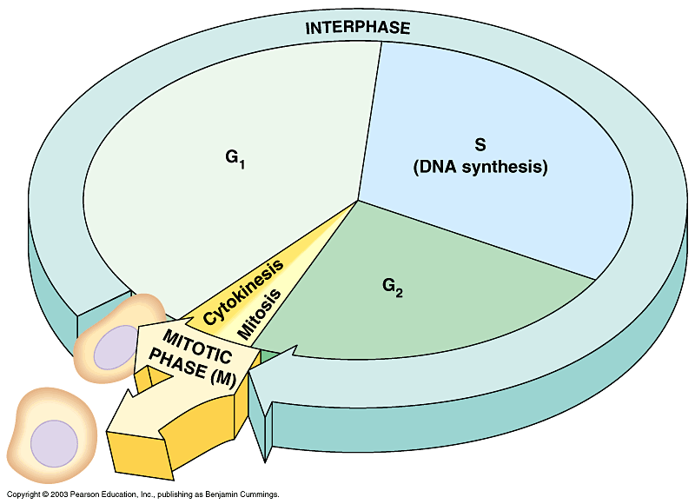
RECAP: The life cycle of a cell
Cell cycle consists of 2 major phases
  Interphase, where chromosomes duplicate
  and cell parts
  are made
  The mitotic
  phase, when
  nuclear division
  occurs
Figure 8.5

Slide 5
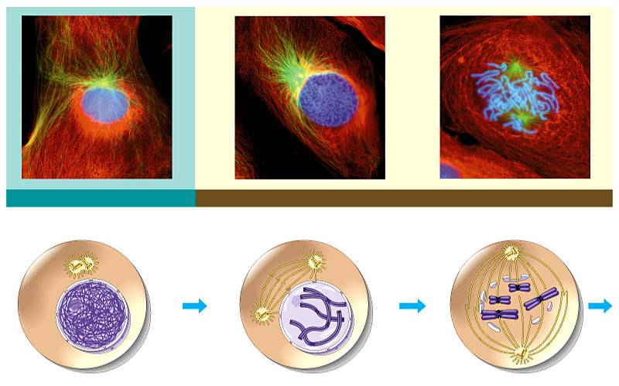
RECAP:
INTERPHASE
PROPHASE
Centrosomes
(with centriole pairs)
Early mitotic
spindle
Centrosome
Fragments
of nuclear
envelope
Kinetochore
Chromatin
Centrosome
Spindle
microtubules
Nucleolus
Nuclear
envelope
Plasma
membrane
Chromosome,
consisting of two
sister chromatids
Figure 8.6

Slide 6
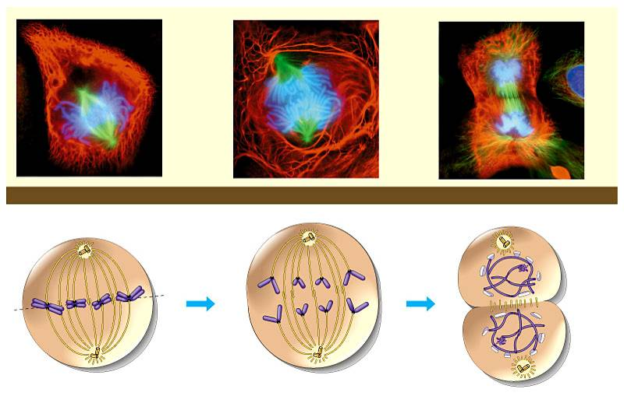
RECAP:
METAPHASE
ANAPHASE
TELOPHASE AND CYTOKINESIS
Metaphase
plate
Cleavage
furrow
Nucleolus
forming
Spindle
Daughter
chromosomes
Nuclear
envelope
forming
Figure 8.6 (continued)

Slide 7
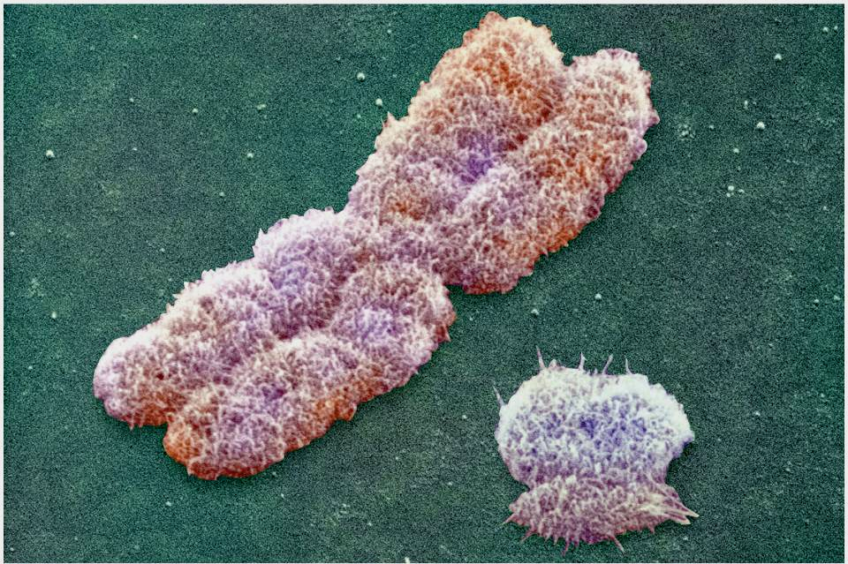
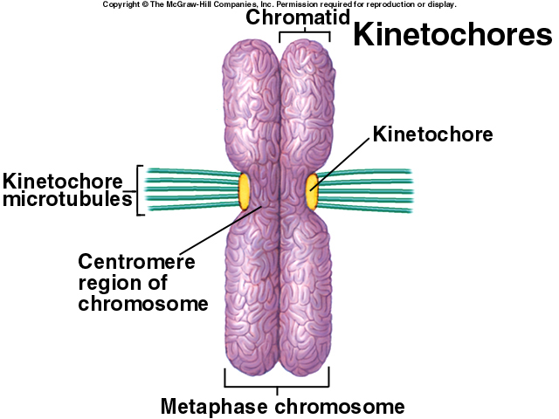
X chromosome

Slide 8
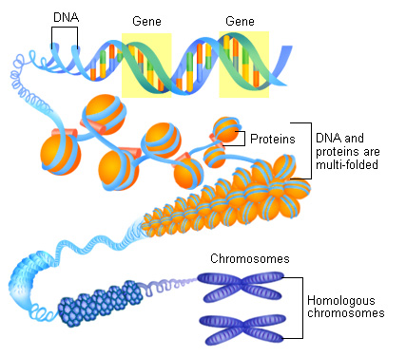
DNA, Chromatin and Chromosome
This is where we see chromosome as discrete entities under microscope

Slide 9
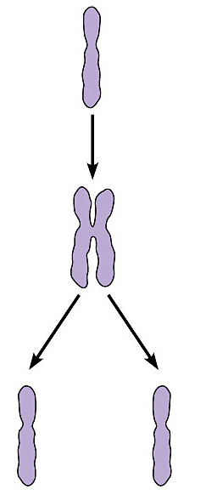
Mother
cell
When the cell divides, the sister chromatids separate
Chromosome
duplication
  Two daughter cells are produced
  Each has a complete and identical set of chromosomes
Centromere
Sister
chromatids
Daughter
cells
Chromosome
distribution
to
daughter
cells
Figure 8.4C

Slide 10
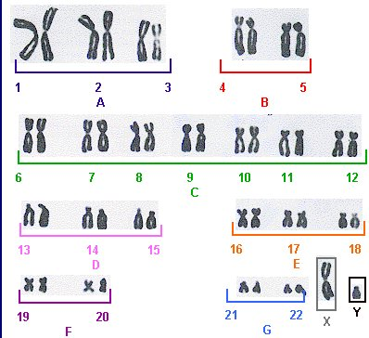
Which one is a chromosome and where are the chromatids?
How do we count chromosome number?
How many ‘sets’ of chromosomes are seen here?
Idea of diploid ‘2n’ and haploid ‘n’ sets
A karyotype (ORDERED ARRANGEMENT) of metaphase chromosomes ( in homologous pairs)

Slide 11
Meiosis –
A process to generate haploid sets of chromosomes
Gamete carry haploid set of chromosomes

Slide 12
Gametes have a single set of chromosomes
Haploid gametes are produced by a special sort of cell division called meiosis
Which occurs only in reproductive organs, ovaries and testes
Purpose of meiosis is to produce sperm and egg and reduce the diploid set of chromosomes to a haploid set

Slide 13
MEIOSIS Hallmarks
Meiosis involves 2 cell divisions
Meiosis produces 4 cells from 1 parental cell
Each of the 4 daughter cells has 23 individual chromosomes rather than 23 pairs of chromosomes
Meiosis reduces the chromosome number from diploid to haploid
Meiosis, like mitosis, is preceded by chromosome duplication
  However, in meiosis the cell divides twice to form four daughter cells

Slide 14
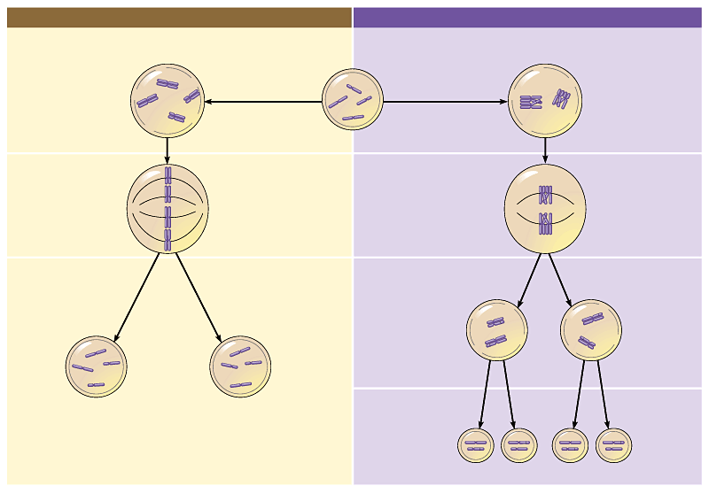
MITOSIS
MEIOSIS
PARENT CELL
(before chromosome replication)
Site of
crossing over
MEIOSIS I
PROPHASE
PROPHASE I
Tetrad formed
by synapsis of
homologous
chromosomes
Duplicated
chromosome
(two sister chromatids)
Chromosome
replication
Chromosome
replication
2n = 4
Chromosomes
align at the
metaphase plate
Tetrads
align at the
Metaphase plate
METAPHASE I
METAPHASE
ANAPHASE
TELOPHASE
Sister chromatids
separate during
anaphase
Homologous
chromosomes
separate
during
anaphase I;
sister
chromatids remain together
ANAPHASE I
TELOPHASE I
Haploid
n = 2
Daughter
cells of
meiosis I
2n
2n
No further chromosomal replication; sister chromatids separate during anaphase II
MEIOSIS II
Daughter cells
of mitosis
n
n
n
n
Daughter cells of meiosis II
Figure 8.15

Slide 15
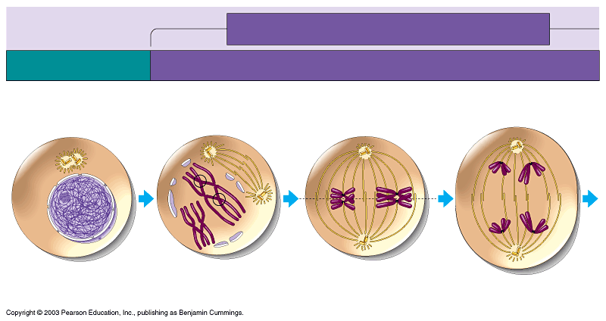
MEIOSIS I: Homologous chromosomes separate
INTERPHASE
PROPHASE I
METAPHASE I
ANAPHASE I
Centrosomes
(with
centriole
pairs)
Sites of crossing over
Microtubules attached to
kinetochore
Metaphase
plate
Sister chromatids
remain attached
Spindle
Nuclear
envelope
Chromatin
Sister
chromatids
Tetrad
Centromere
(with kinetochore)
Homologous
chromosomes separate
Note the separation of paired chromosomes and NOT that of chromatids
Figure 8.14, part 1

Slide 16
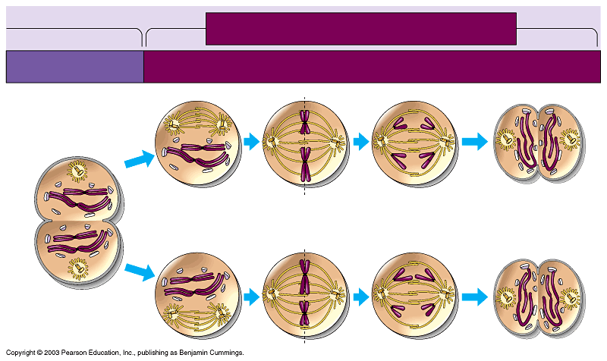
MEIOSIS II: Sister chromatids separate
TELOPHASE I
AND CYTOKINESIS
PROPHASE II
METAPHASE II
ANAPHASE II
TELOPHASE II
AND CYTOKINESIS
Cleavage
furrow
Sister chromatids
separate
Haploid
daughter cells
forming
This time chromatids separate
Figure 8.14, part 2

Slide 17
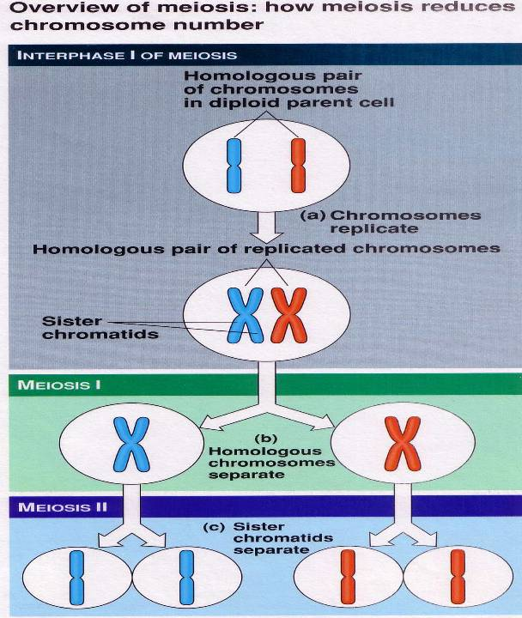

Slide 18
Are there are practical benefits of understanding the link between chromosomes and phenotypes?

Slide 19
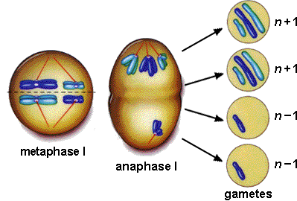
The Culprit: Non-disjunction
Older women are more likely than younger women to evidence chromosome damage and meiotic irregularities

Slide 20
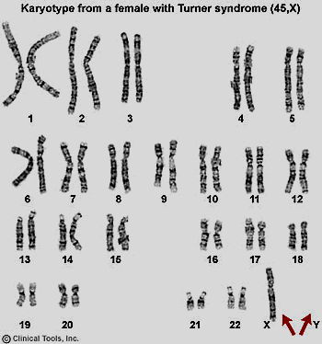
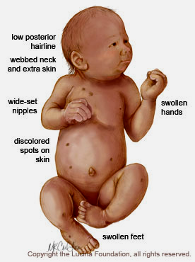
The Culprit: Non-disjunction
Appearance wise, will a Turner be a male or female?
Monosomy: Turner’s Syndrome: 44+X

Slide 21
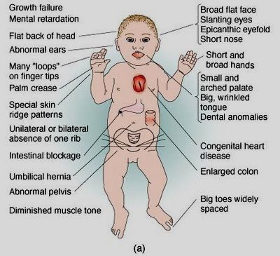
The Culprit: Non-disjunction
Will person afflicted with Down’s syndrome be a male or a female??
Trisomy of chromosome . 21: Down’s
Syndrome: 45+XY/45+XX
Other disorders: Trisomy-13 (47:+13), Trisomy-18 (47:+18),
Klinefelter Syndrome (44+XXY), Triple X syndrome (44+XXX), XYY trisomy (44+XYY)

Slide 22
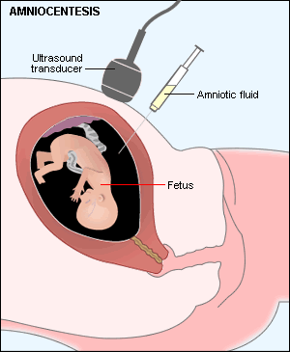
Pre-natal Diagnosis: Amniocentesis
Fetal cells present in amniotic fluid are then cultured and analyzed for chromosomes (by karyotyping) and other biochemical tests
Food for thought:
Genetic defects like thalassemia and hemophophilia represent change in DNA sequence since these are caused by ‘Mutation’.
Can such defects be detected by looking for chromosomal defects (chromosome number or type), for instance?
Ethical question?
When should one examine the chromosome or DNA of the unborn/fetus?

Slide 23
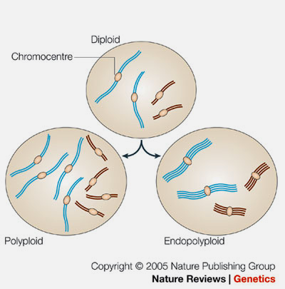
What if entire sets of chromosome do not separate? Error in chromosome sets
Triploidy, in human is usually due to polyspermy and occurs in about 2-3% of all human pregnancies and ~15% of miscarriages

Slide 24
Chromosome numbers versus sets
What if individual chromosomes do not separate during meiosis? Error in chromosome number
What if entire sets of chromosome do not separate? Error in chromosome sets

Slide 25
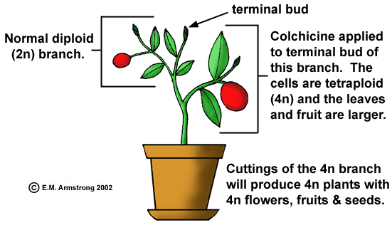
Polyploidy in plants
Colchicine inhibits chromosome segregation

Slide 26
Polyploidy in plants
In nature 3n, 4n, 6n and 8n plants are very common
Many varieties of wheat, cotton, banana, tobacco , strawberries etc are polyploids
Polyploidy results in bigger grain or fruit sizes and high yield which is beneficial
Thus, polyploidy is also artificially induced in plants by breeders using colchicine.

Slide 27

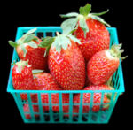
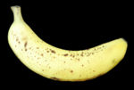
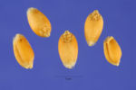
Potato flowers. Potato is an autotetraploid.
The cultivated strawberry is an octaploid hybrid derived from hybridization of two natural octaploids.
This supermarket banana is most likely the common variety Cavendish, an autotriploid of Musa acuminata
Seeds of bread wheat. Wheat is a allohexaploid. Its genome consists of three ancestral parental genomes

Slide 28
TEST your understanding
How many sets of chromosome sdo we carry?
2. How many versions (alleles) of a gene can we carry if every chromosome is in pair?
3. What happens during the gamete formation (meiosis) ? Do the gene pairs stay together?
4. What happens then to the paternal and maternal sets of genes that we inherited ?

Slide 29
Which one is a chromosome and which one is a chromatid?
How do we count chromosomes?
Which ones are autosomes and which ones are sex chromosomes?
A karyotype

Slide 30
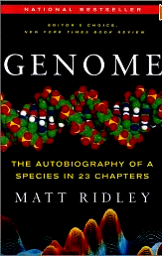
Can we think of our genome (total genetic information in a single cell) as book of life as do some authors?
Here ‘book of life’ is a metaphor
लाक्षणिक रूप से उपमा
Does a cell read these chapters one by one - in a sequence?
What is implied when one says that genetic information is being readout?
Why did the author say that human genome is written in 23 chapters? Why not 46?
RECAP
What is a gene/ Mendelian factor:
a letter,
a word or
a sentence?
AUTOBIOGRAPHY OF A SPECIES IN 23 CHAPTERS
Approximate gene numbers
Chromosome 1 : 4220
Chromosome 2 : 1,491
Chromosome 3 : 1,550

Slide 31
Next lecture:
We would examine the nature of genetic material and how genetic information flows within a cell

